Slide 1

Chapter 10
Pointers and Dynamic Arrays
Copyright © 2017 Pearson Education, Ltd. All rights reserved.

Slide 2
Learning Objectives
Pointers
Pointer variables
Memory management
Dynamic Arrays
Creating and using
Pointer arithmetic
Classes, Pointers, Dynamic Arrays
The this pointer
Destructors, copy constructors

Slide 3
Pointer Introduction
Pointer definition:
Memory address of a variable
Recall: memory divided
Numbered memory locations (called bytes)
Addresses used as name for variable
You’ve used pointers already!
Call-by-reference parameters
Address of actual argument was passed

Slide 4
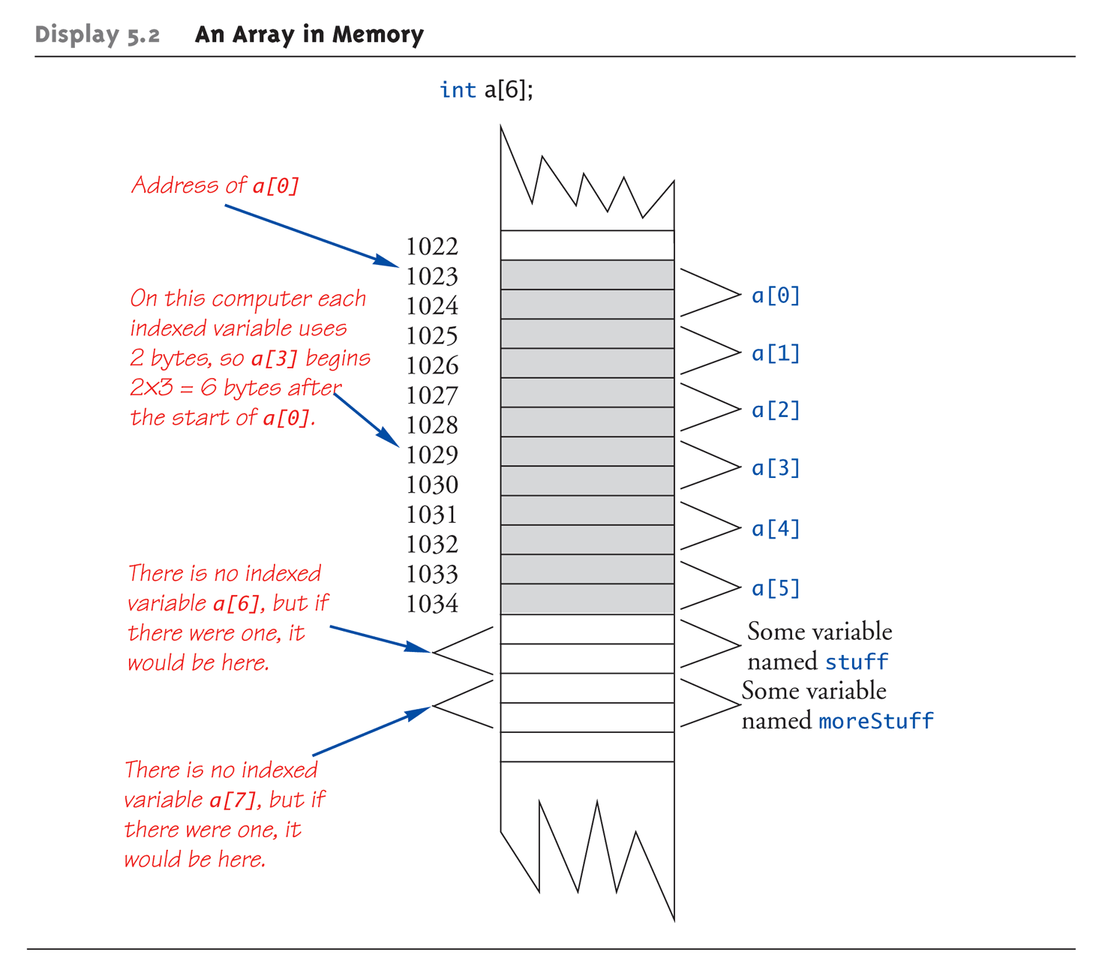
Pointer Introduction

Slide 5
Pointer Variables
Pointers are "typed"
Can store pointer in variable
Not int, double, etc.
Instead: A POINTER to int, double, etc.!
Example: double *p;
p is declared a "pointer to double" variable
Can hold pointers to variables of type double
Not other types! (unless typecast, but could be dangerous)

Slide 6
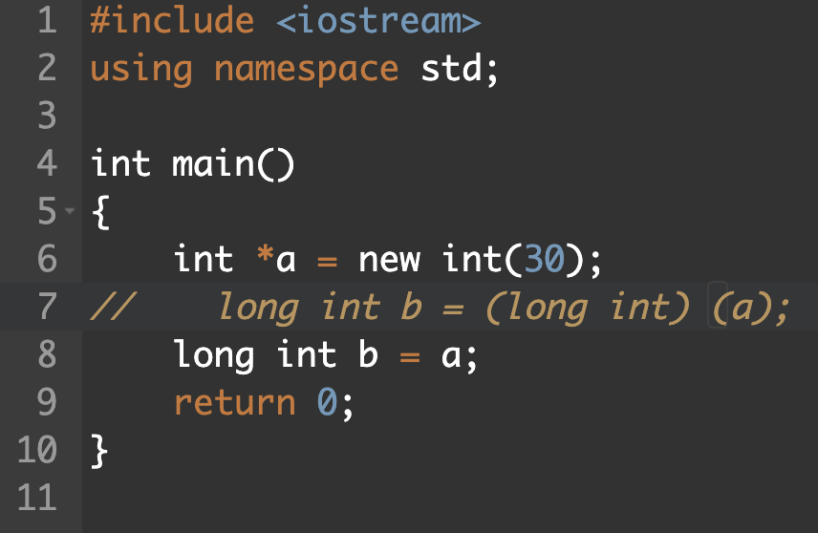
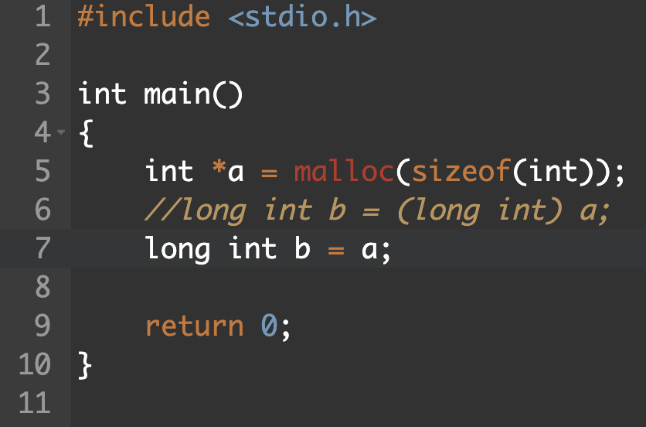
Notes:
C++ error
C warning

Slide 7
Declaring Pointer Variables
Pointers declared like other types
Add "*" before variable name
Produces "pointer to" that type
"*" must be before each variable
int *p1, *p2, v1, v2;
p1, p2 hold pointers to int variables
v1, v2 are ordinary int variables

Slide 8
Addresses and Numbers
Pointer is an address
Address is an integer
Pointer is NOT an integer!
Not crazy → abstraction!
C++ forces pointers be used as addresses
Cannot be used as numbers
Even though it "is a" number
You cannot write pc = pa + pb
Notes:
雖然 pointer 存的 address 實際上是 int，但 C++ 不把它當作 int，只把它當成是 address，不能用 int 的運算方式

Slide 9
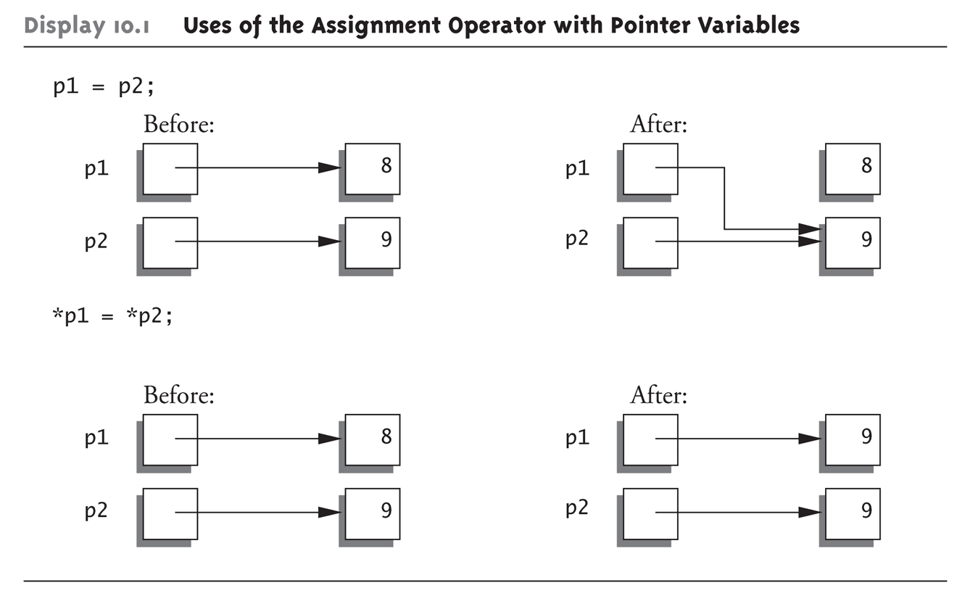
Pointing
Terminology, view
Talk of "pointing", not "addresses"
Pointer variable "points to" ordinary variable
Leave "address" talk out
Makes visualization clearer
"See" memory references
Arrows

Slide 10
Pointing to …
int *p1, *p2, v1, v2; p1 = &v1;
Sets pointer variable p1 to "point to" int variable v1
Operator, &
Determines "address of" variable
Read like:
"p1 equals address of v1"
Or "p1 points to v1"

Slide 11
Pointing to …
Recall: int *p1, *p2, v1, v2; p1 = &v1;
Two ways to refer to v1 now:
Variable v1 itself: cout << v1;
Via pointer p1: cout *p1;
Dereference operator, *
Pointer variable "derereferenced"
Means: "Get data that p1 points to"

Slide 12
"Pointing to" Example
Consider: v1 = 0; p1 = &v1; *p1 = 42; cout << v1 << endl; cout << *p1 << endl;
Produces output: 42 42
p1 and v1 refer to same variable

Slide 13
& Operator
The "address of" operator
p = &a;
Also used to specify call-by-reference parameter
void function (int &p); and function (a);
No coincidence!
Recall: call-by-reference parameters pass "address of" the actual argument
Operator’s two uses are closely related

Slide 14
Pointer Assignments
Pointer variables can be "assigned": int *p1, *p2; p2 = p1;
Assigns one pointer to another
"Make p2 point to where p1 points"
Do not confuse with: *p1 = *p2;
Assigns "value pointed to" by p1, to "value pointed to" by p2

Slide 15
Pointer Assignments Graphic: Display 10.1 Uses of the Assignment Operator with Pointer Variables

Slide 17
Recall Memory Allocation & Cleanup
Notes:
Compiler 管 operator （喔喔喔有解了）

Slide 18
Recall Constructors (1/2)
Most of C bugs occur when the users forgets to initialize or clean up a variable
Users don’t know how to initialize a struct, or even that they must

Slide 19
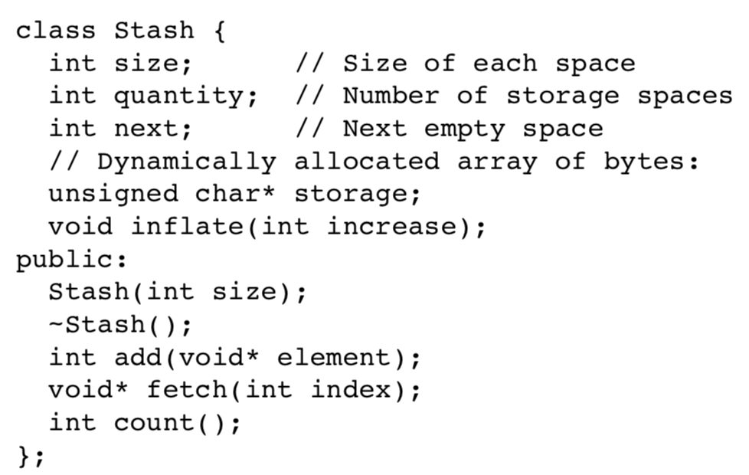
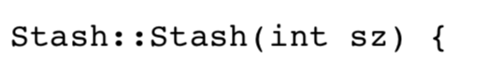
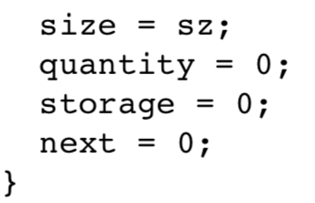
Recall Constructors (2/2)
You can replace function initialize() with a constructor

Slide 20
Dynamic Object Creation
Sometimes you know the exact quantity, type, and lifetime of the objects in your program
But not always
Allocate storage from the heap
In C, we use malloc () and free ()
But, malloc () and free () does not initialize and cleanup the object
They are outside the control of compiler
How to guarantee proper initialization and cleanup?
Notes:
malloc 和 free 是 functions 不歸 compiler 管，compiler 沒辦法幫你整理 code，置換成 initialize 和 delete

Slide 21
The new Operator
Since pointers can refer to variables…
No "real" need to have a standard identifier
Can dynamically allocate variables
Operator new creates variables
No identifiers to refer to them
Just a pointer!
p1 = new int;
Creates new "nameless" variable, and assigns p1 to "point to" it
Can access with *p1
Use just like ordinary variable
Notes:
因爲指標可以指到變數位置，因此其實也可以產生沒有 id 的變數

Slide 22
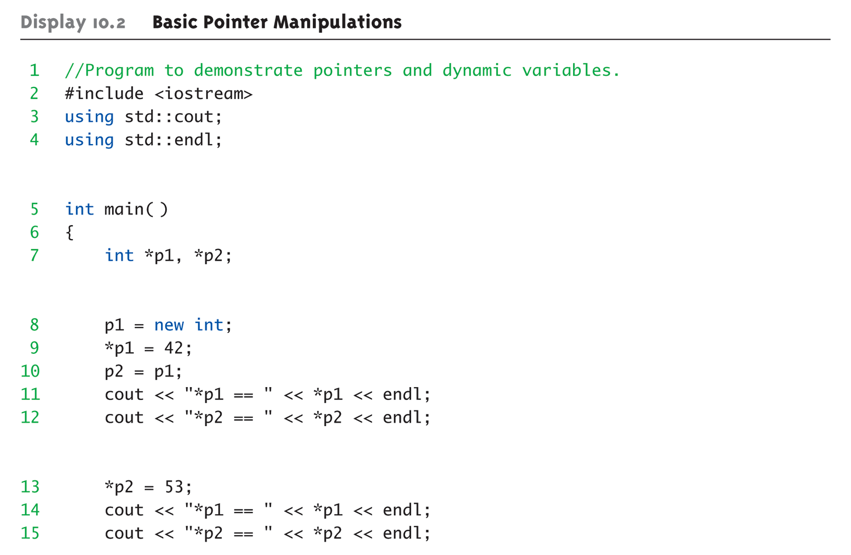
Basic Pointer Manipulations Example: Display 10.2 Basic Pointer Manipulations (1 of 2)

Slide 23
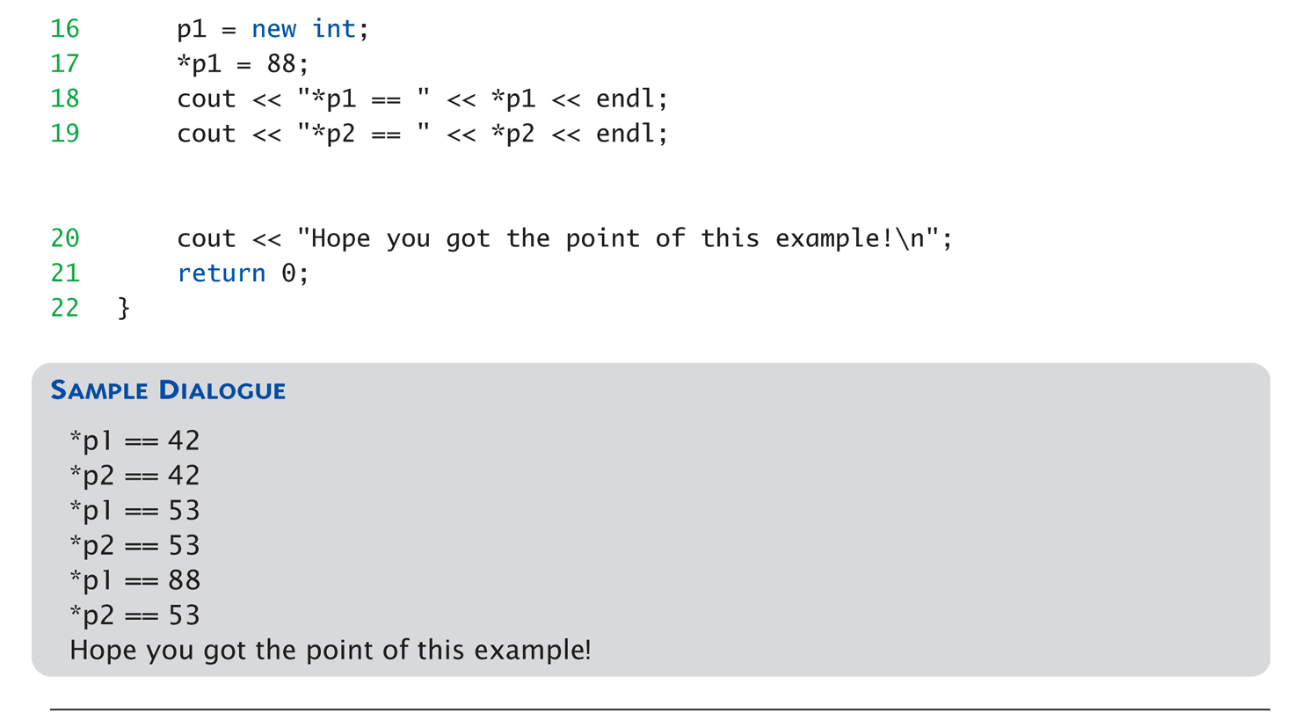
Basic Pointer Manipulations Example: Display 10.2 Basic Pointer Manipulations (2 of 2)

Slide 24
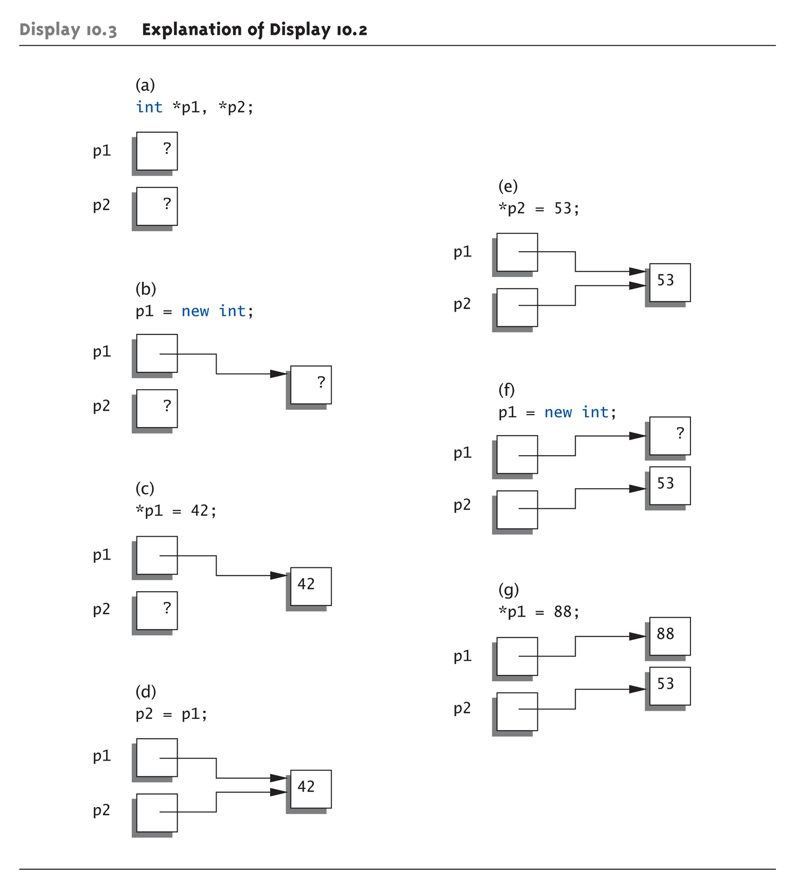
Basic Pointer Manipulations Graphic: Display 10.3 Explanation of Display 10.2

Slide 25
More on new Operator
Creates new dynamic variable
Returns pointer to the new variable
If type is class type:
Constructor is called for new object
Can invoke different constructor with initializer arguments: MyClass *mcPtr; mcPtr = new MyClass(32.0, 17);
Can still initialize non-class types: int *n; n = new int(17); //Initializes *n to 17

Slide 26
Pointers and Functions
Pointers are full-fledged types
Can be used just like other types
Can be function parameters
Can be returned from functions
Example: int* findOtherPointer(int* p);
This function declaration:
Has "pointer to an int" parameter
Returns "pointer to an int" variable

Slide 28
Memory Management
Heap
Also called "freestore"
Reserved for dynamically-allocated variables
All new dynamic variables consume memory in freestore
If too many → could use all freestore memory
Future “new” operations will fail if freestore is "full"

Slide 29
Checking new Success
Older compilers:
Test if null returned by call to new: int *p; p = new int; if (p == NULL) // NULL represents empty pointer { cout << "Error: Insufficient memory.\n"; exit(1); }
If new succeeded, program continues

Slide 30
new Success – New Compiler
Newer compilers:
If new operation fails:
Program terminates automatically
Produces error message
Still good practice to use NULL check
NULL represents the empty pointer or a pointer to nothing and will be used later to mark the end of a list

Slide 31
C++11 nullptr
NULL is actually the number 0 and can lead to ambiguity
Which func is invoked given func(NULL)? Both are equally valid since NULL is 0
C++11 resolves this problem by introducing a new constant, nullptr
nullptr is not 0
Can use anywhere you could use NULL
void func(int *p); void func(int i);

Slide 32
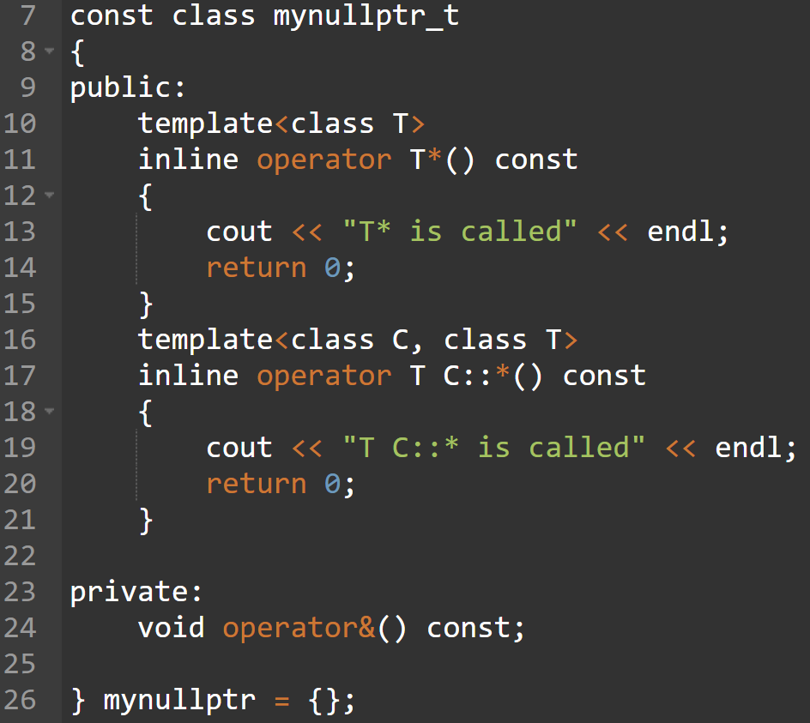
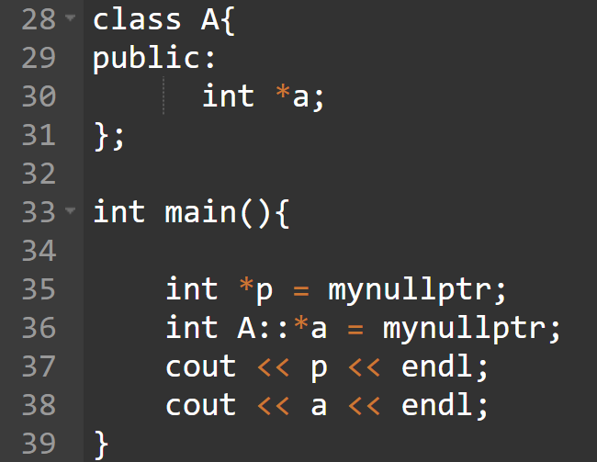
Implement nullptr

Slide 33
Freestore Size
Varies with implementations
Typically large
Most programs won’t use all memory
32-bit: 4GB, 64-bit: 8TB
Memory management
Still good practice
Solid software engineering principle
Memory IS finite
Regardless of how much there is!
Notes:
自己管理記憶體是仍是重要的事，因為記憶體不是無窮無盡，總會有消耗完的一天

Slide 34
delete Operator
De-allocate dynamic memory
When no longer needed
Returns memory to freestore
Example: int *p; p = new int(5); … //Some processing… delete p;
De-allocates dynamic memory "pointed to by pointer p"
Literally "destroys" memory

Slide 35
Dangling Pointers
delete p;
Destroys dynamic memory
But p still points there!
Called "dangling pointer"
If p is then dereferenced ( *p )
Unpredictable results!
Often disastrous!
Avoid dangling pointers
Assign pointer to NULL after delete: delete p; p = NULL;
Notes:
迷途指標，他指向的位置沒有東西
C++ 不會幫你檢查這個，自己要小心

Slide 37
Dynamic and Automatic Variables
Dynamic variables
Created with new operator
Created and destroyed while program runs
Local variables
Declared within function definition
Not dynamic
Created when function is called
Destroyed when function call completes
Often called "automatic" variables
Properties controlled for you

Slide 38
Define Pointer Types
Can "name" pointer types
To be able to declare pointers like other variables
Eliminate need for "*" in pointer declaration
typedef int* IntPtr;
Defines a "new type" alias
Consider these declarations: IntPtr p; int *p;
The two are equivalent
Notes:
這個資料結構也講過很多次

Slide 39
Pitfall: Call-by-value Pointers
Behavior subtle and troublesome
If function changes pointer parameter itself → only change is to local copy
Best illustrated with example…
Notes:
這其實就是我之前有提到的 C 沒有 call by reference，pointer 雖然能改到 value，但是他其實是 call by value 的概念

Slide 40
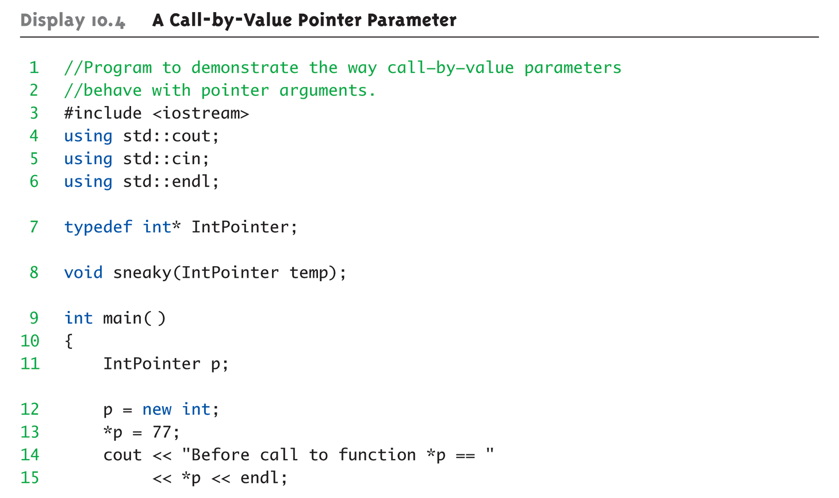
Call-by-value Pointers Example: Display 10.4 A Call-by-Value Pointer Parameter (1 of 2)

Slide 41
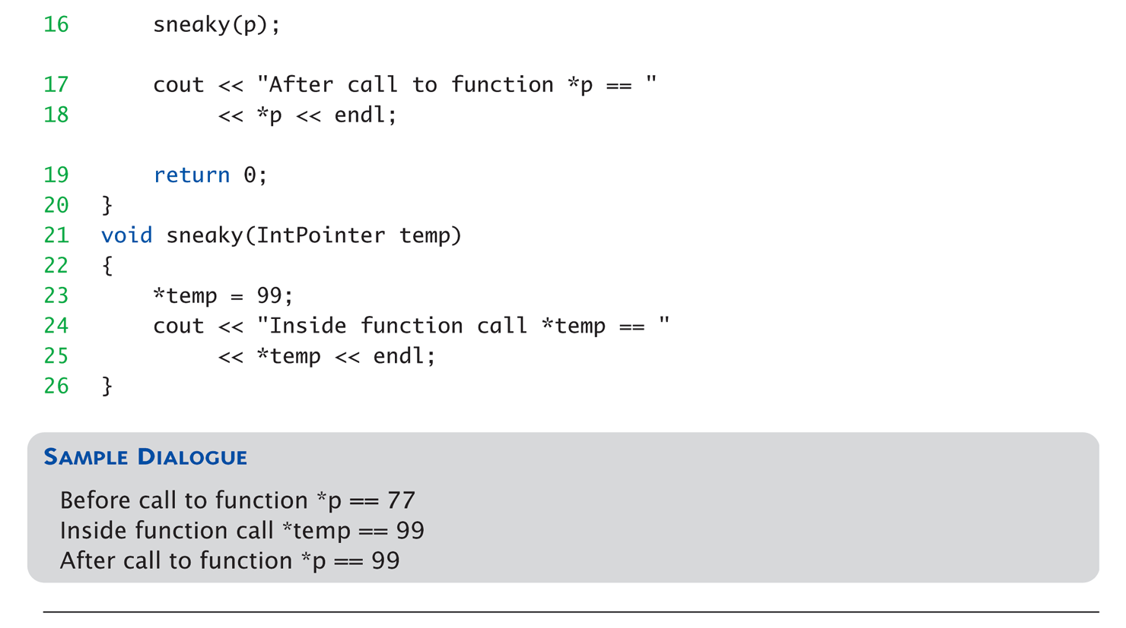
Call-by-value Pointers Example: Display 10.4 A Call-by-Value Pointer Parameter (2 of 2)

Slide 42
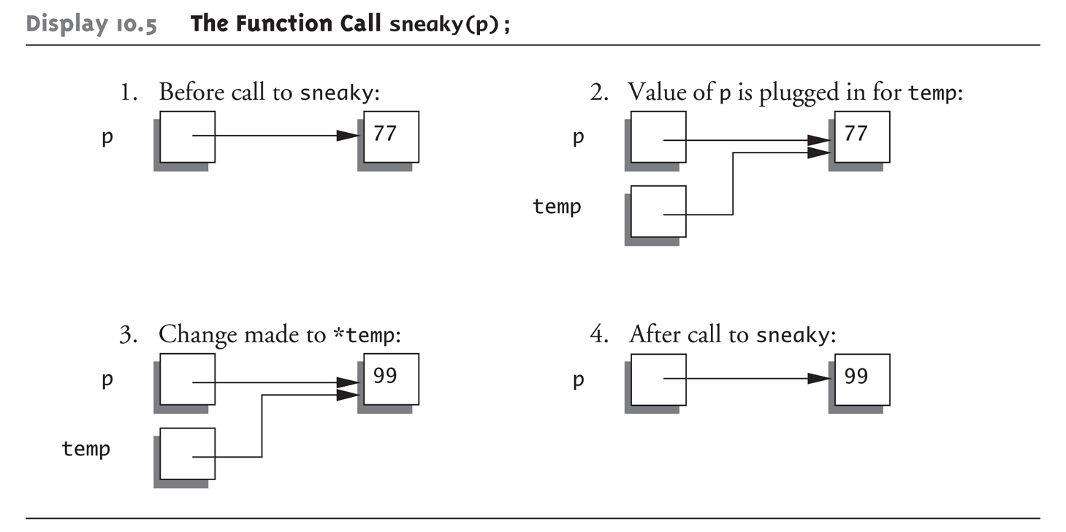
Call-by-value Pointers Graphic: Display 10.5 The Function Call sneaky(p);

Slide 43
Unless…
You use void sneaky( int ** pPtr); int main() { int* p; sneaky(&p); }
But this is dangerous

Slide 44
Dynamic Arrays
Array variables
Really pointer variables!
Standard array
Fixed size
Dynamic array
Size not specified at programming time
Determined while program running

Slide 45
Array Variables
Recall: arrays stored in memory addresses, sequentially
Array variable "refers to" first indexed variable
So array variable is a kind of pointer variable!
Example: int a[10]; int * p;
a and p are both pointer variables!

Slide 46
Array Variables → Pointers
Recall previous example: int a[10]; typedef int* IntPtr; IntPtr p;
a and p are pointer variables
Can perform assignments: p = a; // Legal.
p now points where a points
To first indexed variable of array a
a = p; // ILLEGAL!
Array pointer is CONSTANT pointer!
Notes:
Array a 雖然也是指標，但他是不能改動裡面的值（不能改指其他地方）

Slide 47
Array Variables → Pointers
Array variable int a[10];
MORE than a pointer variable
const version of "int *" type
Array was allocated in memory already
Variable a MUST point there…always!
Cannot be changed!
In contrast to ordinary pointers
Which can (& typically do) change

Slide 48
Dynamic Arrays
(Static) Array limitations
Must specify size first
May not know until program runs!
Must "estimate" maximum size needed
Sometimes OK, sometimes not
"Wastes" memory
Dynamic arrays
Can grow and shrink as needed
Notes:
什麼情況下會用到 Dynamic array，就是當你不確定大小的時候

Slide 49
Creating Dynamic Arrays
Very simple!
Use new operator
Dynamically allocate with pointer variable
Treat like standard arrays
Example: typedef double * DoublePtr; DoublePtr d; d = new double[10]; //Size in brackets
Creates dynamically allocated array variable d, with ten elements, base type double

Slide 50
Deleting Dynamic Arrays
Allocated dynamically at run-time
So should be destroyed at run-time
Simple again. Recall Example: d = new double[10]; … //Processing delete [] d;
De-allocates all memory for dynamic array
Brackets indicate "array" is there
Recall: d still points there!
Should set d = NULL;

Slide 51
Function that Returns an Array
Array type NOT allowed as return-type of function
Example: int [] someFunction(); // ILLEGAL!
Instead return pointer to array base type: int* someFunction(); // LEGAL!

Slide 52
Pointer Arithmetic
Can perform arithmetic on pointers
"Address" arithmetic
Example: typedef double* DoublePtr; DoublePtr d; d = new double[10];
d contains address of d[0]
d + 1 evaluates to address of d[1]
d + 2 evaluates to address of d[2]
Equates to "address" at these locations
Notes:
問他們 d + 1 會變成什麼
假設原本 0xb9ace0, 0xb9ace8
如果 d 是 int type 呢？
那就會是 0xb9ace0, 0xb9ace4
in fact, +1 → +4 in address

Slide 53
Alternative Array Manipulation
Use pointer arithmetic!
"Step thru" array without indexing: for (int i = 0; i < arraySize; i++) cout << *(d + i) << " " ;
Equivalent to: for (int i = 0; i < arraySize; i++) cout << d[i] << " " ;
Only addition/subtraction on pointers
No multiplication, division
Can use ++ and -- on pointers
Notes:
其實你也不能拿兩個 ptr 相加或相減

Slide 54
Multidimensional Dynamic Arrays
Yes we can!
Recall: "arrays of arrays"
Type definitions help "see it": typedef int* IntArrayPtr; IntArrayPtr *m = new IntArrayPtr[3];
Creates array of three pointers
Make each allocate array of 4 ints
for (int i = 0; i < 3; i++) m[i] = new int[4];
Results in three-by-four dynamic array!

Slide 56
Back to Classes
The -> operator
Shorthand notation
Combines dereference operator, *, and dot operator
Specifies member of class "pointed to" by given pointer
Example: MyClass *p; p = new MyClass; p->grade = "A"; Equivalent to: (*p).grade = "A";

Slide 57
The this Pointer
Member function definitions might need to refer to calling object
Use predefined this pointer
Automatically points to calling object: Class Simple { public: void showStuff() const; private: int stuff; };
Two ways for member functions to access: cout << stuff; cout << this->stuff;
Notes:
Cascading 用 return this 來完成

Slide 58
Overloading Assignment Operator
Assignment operator returns reference
So assignment "chains" are possible
e.g., a = b = c;
Sets a and b equal to c
Operator must return "same type" as it’s left-hand side
To allow chains to work
The this pointer will help with this!
Enable (a=b).f()
Notes:
寫等於的 operator overloading 要非常非常小心

Slide 59
Overloading Assignment Operator
Recall: Assignment operator must be member of the class
It has one parameter
Left-operand is calling object Assume s1 is a variable of type "StringClass" s1 = s2;
Think of like: s1.=(s2);
s1 = s2 = s3;
Requires s1 = (s2 = s3);
So (s2 = s3) must return object of s2’s type
And pass to "s1 = ";

Slide 60
Shallow and Deep Copies
Shallow copy
Assignment copies only member variable contents over
Default assignment and copy constructors
Deep copy
Pointers, dynamic memory involved
Must dereference pointer variables to "get to" data for copying
Write your own assignment overload and copy constructor in this case!
Notes:
Default 會帶你住套房

Slide 61
Overloaded = Operator Definition
First version of overloaded "=":
Uses string Class example: StringClass& StringClass::operator=(const StringClass& rtSide) { capacity = rtSide.capacity; length = rtSide.length; delete [] a; a = new char[capacity]; for (int i = 0; i <= length; i++) a[i] = rtSide.a[i]; return *this; }
class StringClass { public: StringClass & operator = (const StringClass & rtSide); private: char * a; int capacity; int length; };

Slide 62
Pitfall: Overloading = Operator
Uses string Class example: StringClass& StringClass::operator=(const StringClass& rtSide) { if (this == &rtSide) // if right side same as left side return *this; else { capacity = rtSide.capacity; length = rtSide.length; delete [] a; a = new char[capacity]; for (int i = 0; i <= length; I++) a[i] = rtSide.a[i]; return *this; } }

Slide 63
Destructor Need
Dynamically-allocated variables
Do not go away until "deleted"
If pointers are only private member data
They dynamically allocate "real" data
In constructor
Must have means to "deallocate" when object is destroyed
Answer: destructor!

Slide 64
Destructors
Opposite of constructor
Automatically called when object is out-of-scope
Default version only removes ordinary variables, not dynamic variables
Defined like constructor, just add ~
MyClass::~MyClass() { //Perform delete clean-up duties }
Use delete to remove variable
Notes:
波浪符號
Tilde
問一個問題，可以用 free 嗎？

Slide 65
Copy Constructors
Automatically called when:
Class object declared and initialized to other object
When function returns class type object
When argument of class type is "plugged in" as actual argument to call-by-value parameter
Requires "temporary copy" of object
Copy constructor creates it
Default copy constructor
Like default "=", performs member-wise copy
Pointers → write own copy constructor!
Notes:
拜託請寫 copy constructor 和 =

Slide 66
Summary 1
Pointer is memory address
Provides indirect reference to variable
Dynamic variables
Created and destroyed while program runs
Freestore
Memory storage for dynamic variables
Dynamically allocated arrays
Size determined as program runs

Slide 67
Summary 2
Class destructor
Special member function
Automatically destroys objects
Copy constructor
Single argument member function
Called automatically when temp copy needed
Assignment operator
Must be overloaded as member function
Returns reference for chaining

